Slide 1
Bibliographic field “Author (contributor)” from 7XX fields
Yoel Kortick. Senior Librarian

Slide 2


Introduction
Examples

Slide 3
Introduction

Slide 4
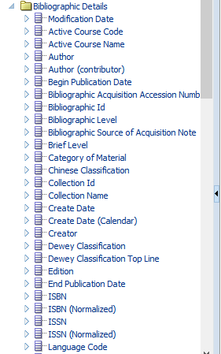
Introduction
As of Jan. 2020 a new bibliographic field “Author (contributor)” has been added to the shared folder “Bibliographic Details”.
This field contains values from the 7XX fields in the bibliographic record.
When there are multiple 7XX fields they get delimited by a semicolon in the “Author (contributed)” field.

Slide 5
Introduction
The specific fields and subfields which comprise the “Author (contributed)” field in Alma Analytics are as follows:
For UNIMARC:
700 a-d,f,p
701 a-d,f,p
702 a-d,f,g
710 a-h,p
711 a-h,p
712 a-h,p
720 a,f
721 a,f
722 a,f
For CNMARC:
700 a-d,f,p,9
701 a-d,f,p,9
702 a-d,f,g,9
710 a-h,p,9
711 a-h,p,9
712 a-h,p,9
720 a,f
721 a,f,9
722 a,f,9
For MARC21 AND KORMARC:
700 a-e,j,q,u
710 a-e,i,n,u
711 a,c-e,i,j,n,q,u

Slide 6
Examples

Slide 7

Example 1
Here is title “An Investigation of the Experimental French Programme at Bedford Park and Allenby Public Schools” which has a 100 field and as well as a 700 and 710 field.
…

Slide 8
Example 1
Here it is in Alma Analytics
From the 700 and 710 fields
From the 100 field

Slide 9
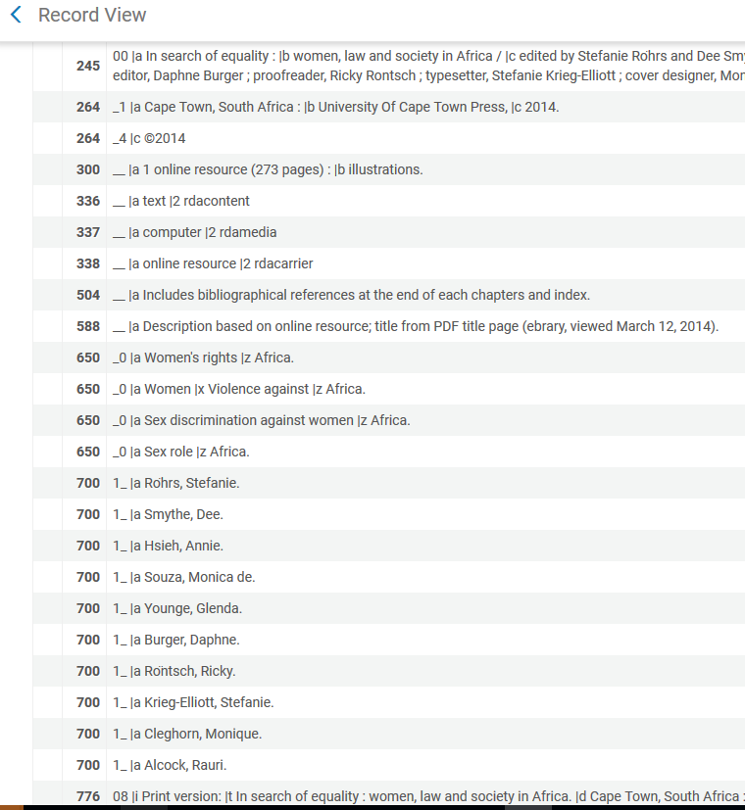
Example 2
Here is title “In search of equality: women, law and society in Africa” which has no 1XX and several 700 fields.

Slide 10
Example 2
Here it is in Alma Analytics
From the 700 fields

Slide 11


Example 3
Here is title “The Returns to Educational Training in Math and Science for American Women” which has a 100, a 700 and a 710
…

Slide 12
Example 3
Here it is in Alma Analytics
From the 700 and 710
From the 100

Slide 13
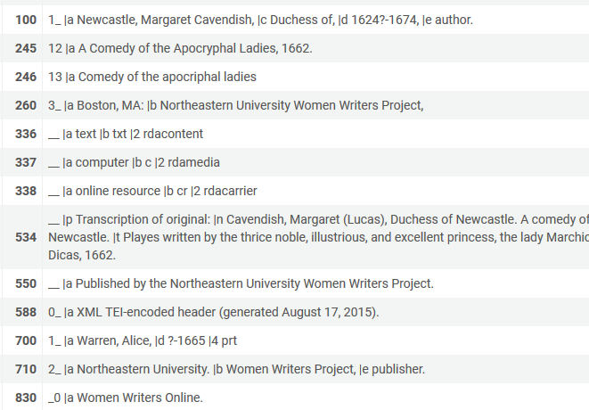
Example 4
Here is title “A Comedy of the Apocryphal Ladies, 1662.” which has a 100, a 700 and a 710

Slide 14
Example 4
Here it is in Alma Analytics
From the 700 and 710
From the 100

Slide 15
Yoel.Kortick@exlibrisgroup.com

